Slide 1
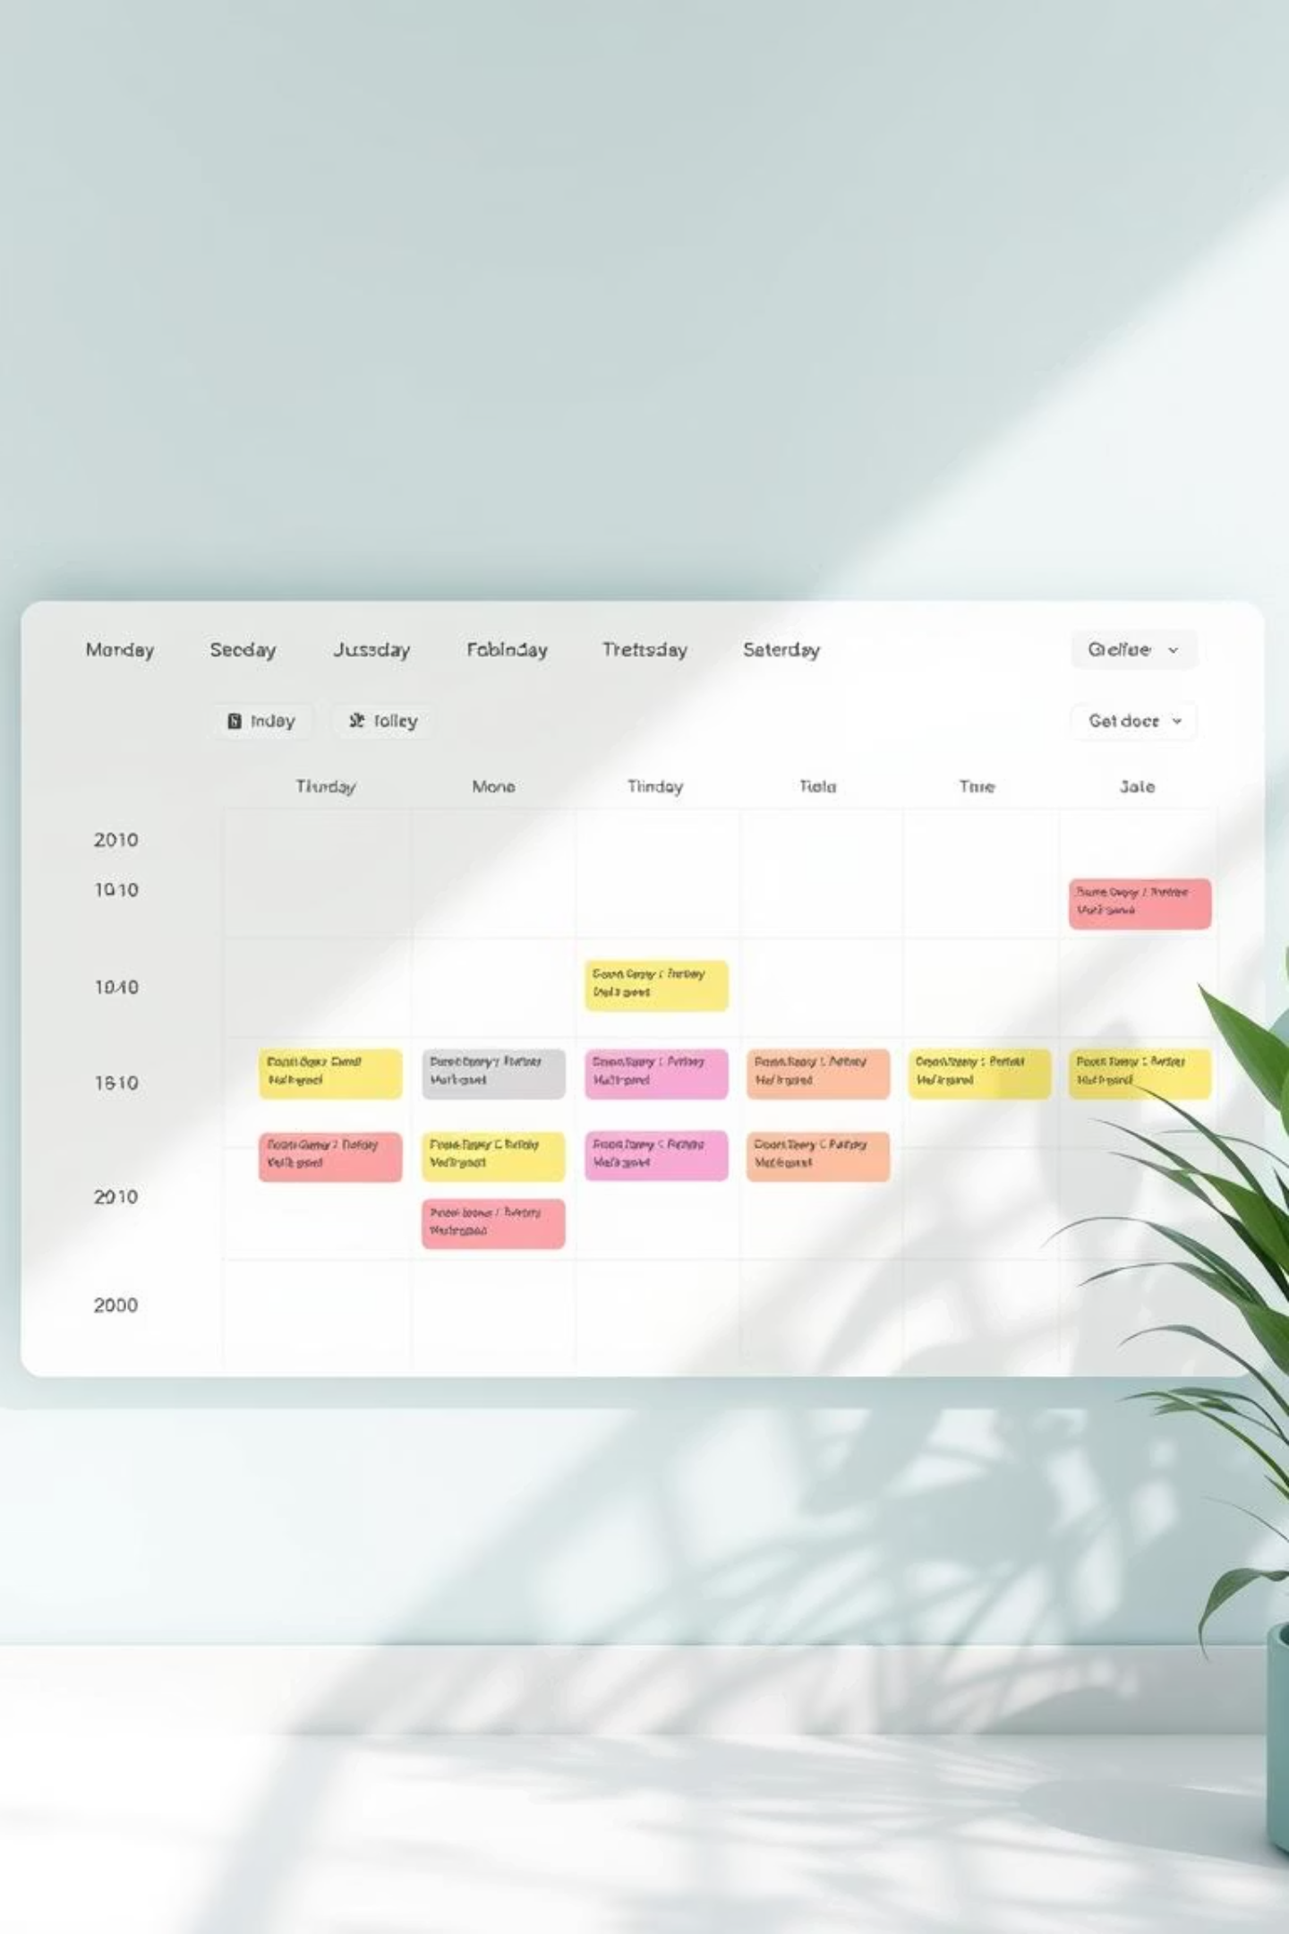
Weekly Timetable Planner
Your Smart Organizer for Classes, Attendance, and Reminders.

Slide 2
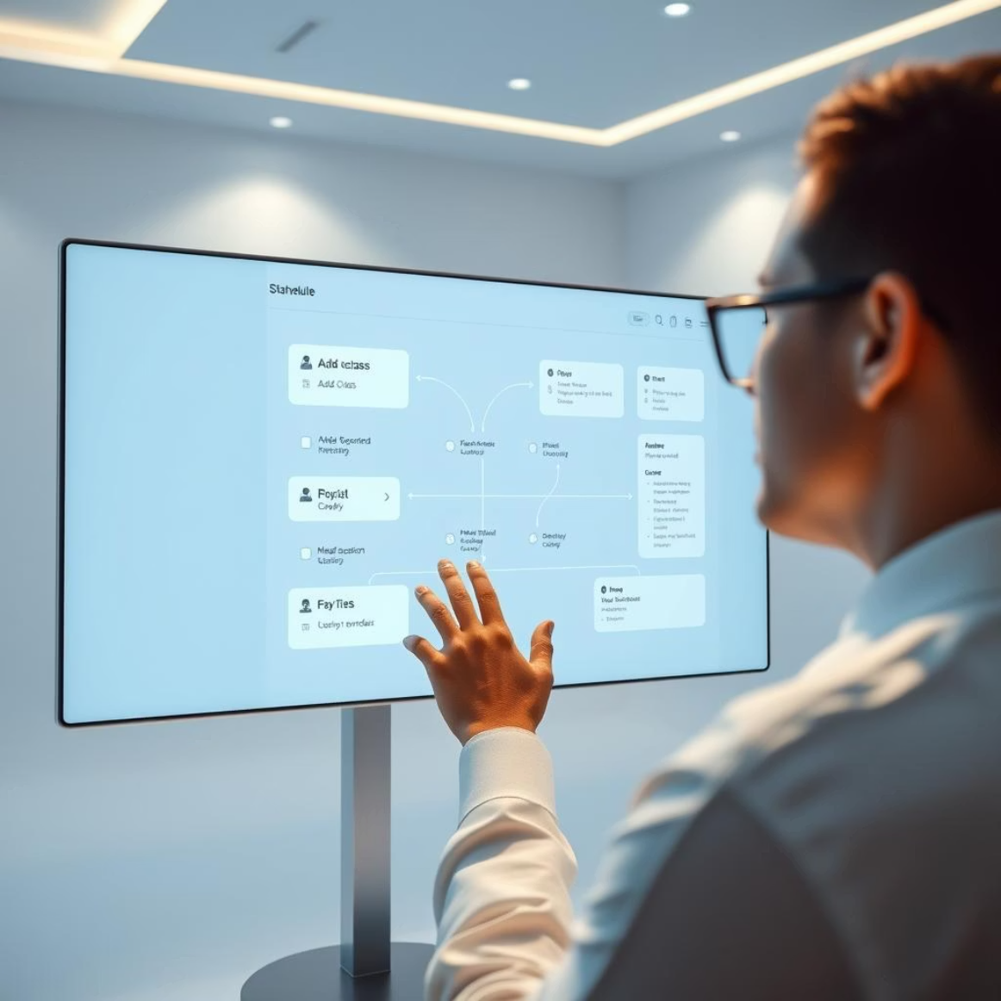
Introducing Your Smart Timetable Solution
01
Effortless Timetable Management
Create, edit, and delete classes effortlessly within a centralized web application.
02
Automated Reminders
Receive automatic notifications before classes, ensuring you're always on time.
03
Attendance Streak Tracking
Get positive reinforcement with notifications celebrating your consistent attendance.
04
Visual Organization
Enjoy a clear, color-coded view of your week, making your schedule intuitive.

Slide 3



Key Features at a Glance
Class Management
Intuitive Day Navigation
Dedicated page for adding, editing, and deleting all your academic classes.
Navigate your week easily with horizontally organized day boxes.
Flexible Time Selection
Visual Cues
Choose between AM/PM for class timings, adapting to your preference.
Classes and days are color-coded for quick visual recognition and organization.
Attendance & Streaks
Timely Notifications
Track attendance seamlessly with motivating streak pop-ups.
Receive automatic browser notifications before classes start.
These core features are designed to create a seamless and productive experience for students.

Slide 4
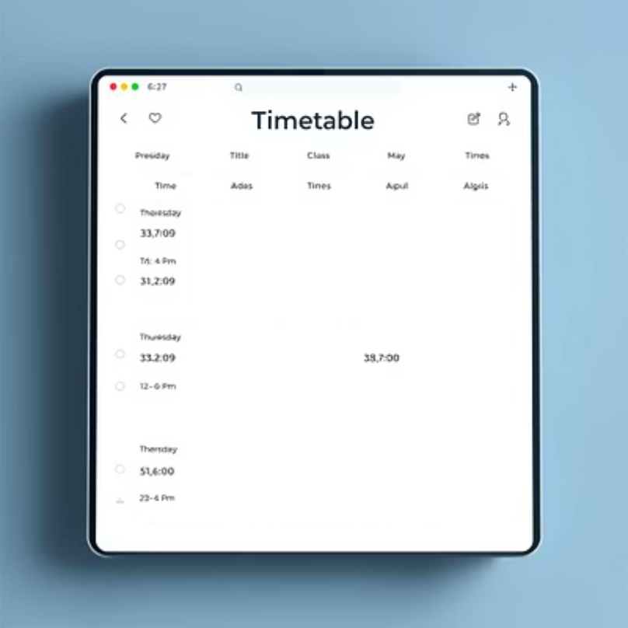
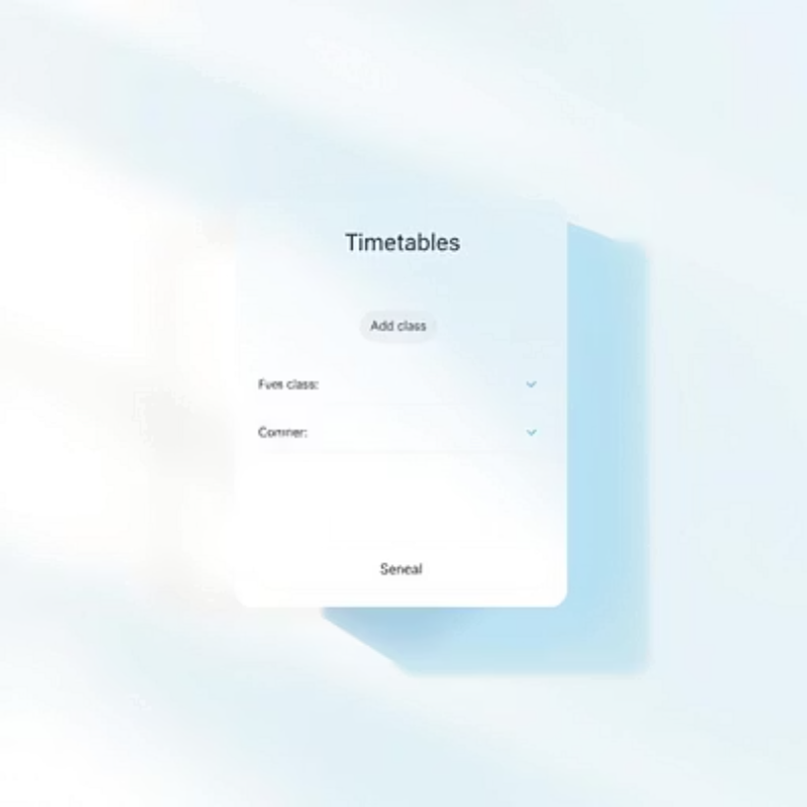
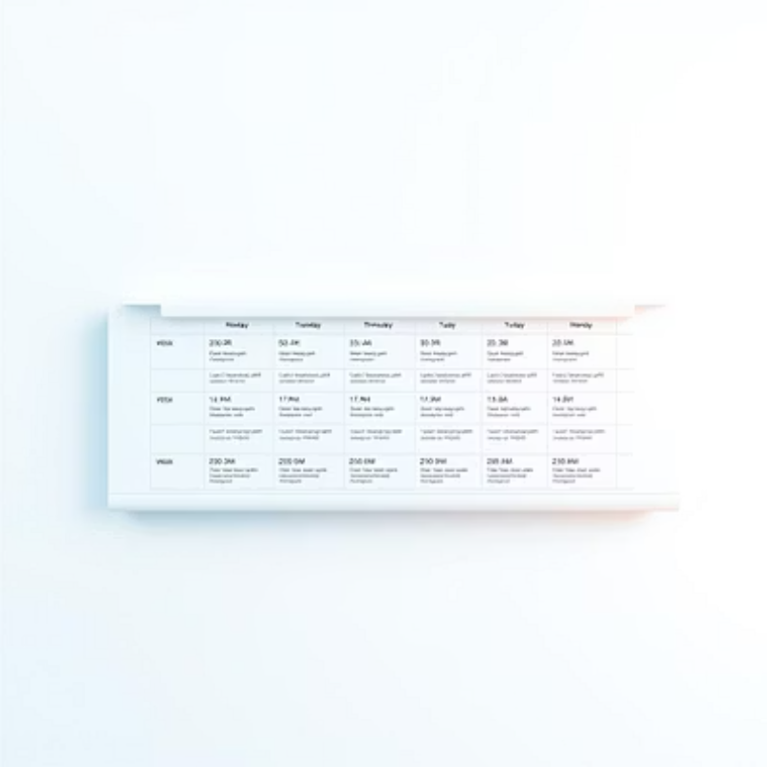
Seamless User Experience
Our timetable web app boasts a clean, intuitive layout, designed for effortless navigation and minimal distraction. We prioritize user-friendliness in every interaction.
Simply click on a specific day to open the `Add Class` page.
Class boxes clearly display the title, time, and quick action buttons for easy management.
Easily scroll horizontally for weeks with many classes, ensuring all your commitments are visible.

Slide 5
Under the Hood: Technical Foundations
Time handling is robust, adapting to AM/PM formats, and subjects are automatically assigned unique colors for visual clarity, all managed through JavaScript logic.
Core Technologies
Built using standard web technologies: HTML, CSS, and JavaScript for robust performance.
// Example: Simplified Class Objectconst classData = { id: Date.now(), title: 'Math', day: 'Monday', time: '10:00 AM', color: '#AEE4BD'};localStorage.setItem('classes', JSON.stringify(classes));console.log('Class saved!');
Local Data Storage
All class and attendance data are securely stored using LocalStorage in your browser.
Browser Notifications
Leveraging the Notification API for timely and effective class reminders.

Slide 6
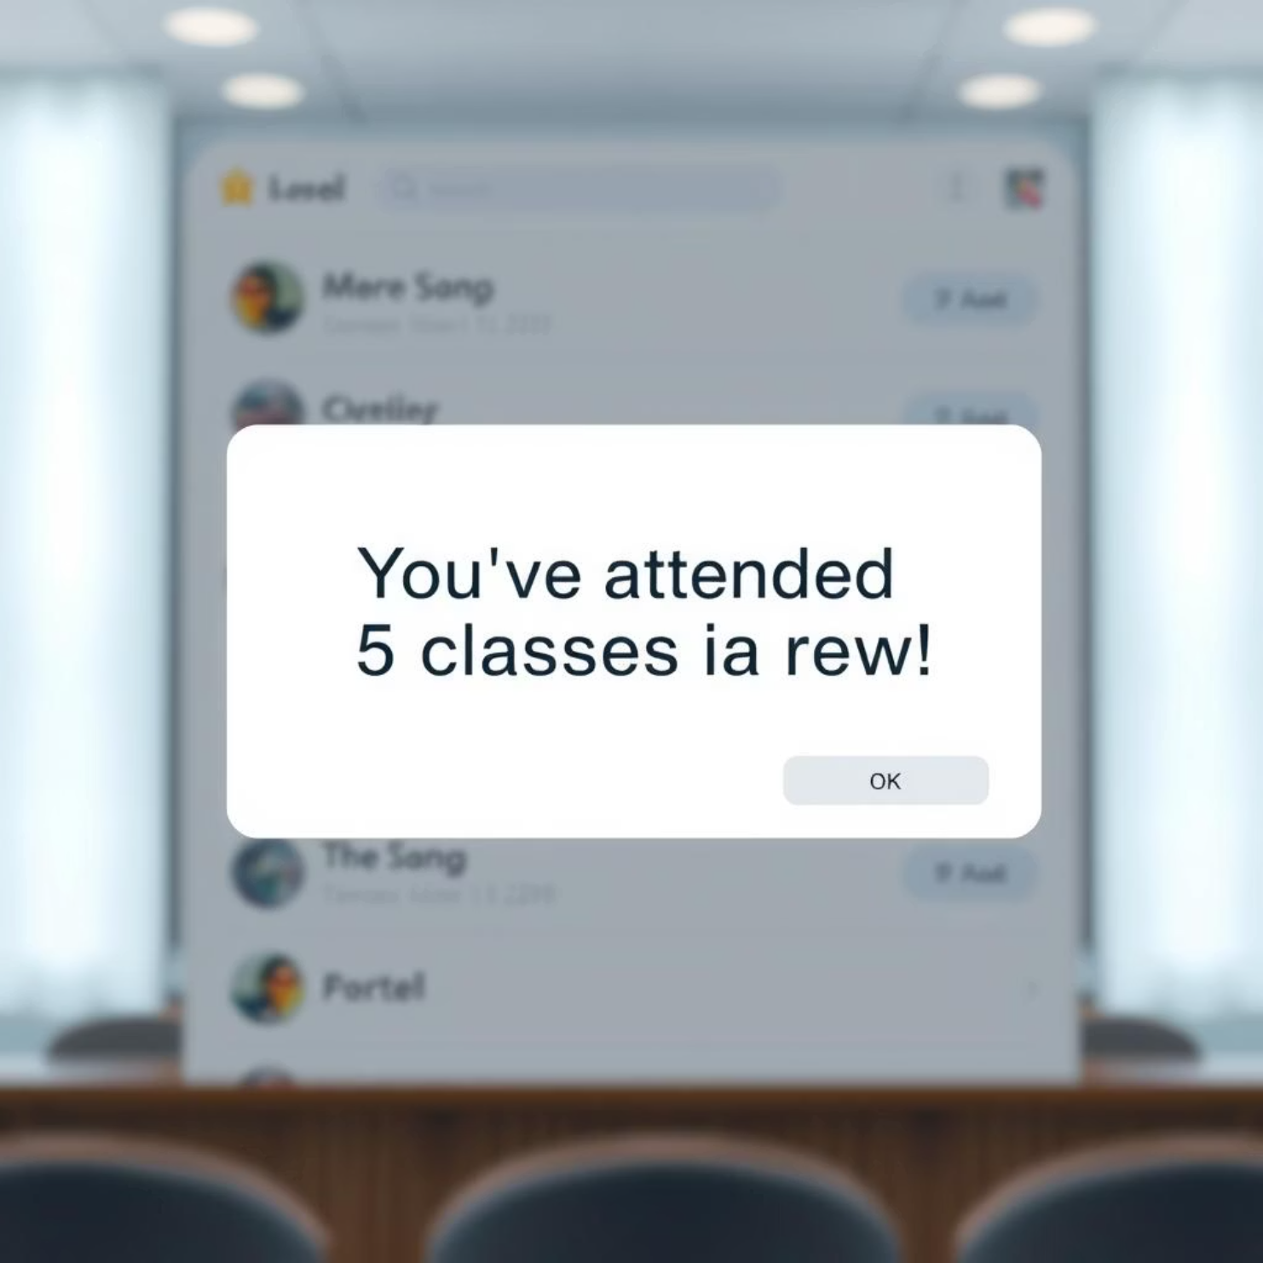
Boost Your Consistency: The Attendance Tracker
Our integrated attendance feature makes logging your presence a breeze. Simply click the 'Attend' button on a class, and your attendance is instantly recorded.
What truly sets it apart are the motivating streak notifications! Imagine seeing a pop-up celebrating:
"You've attended 5 classes in a row! Keep up the great work!"
This positive reinforcement is designed to encourage consistent attendance and build good habits, turning every class into a step towards your academic goals.
Celebrate Your Streaks!

Slide 7

Never Miss a Moment: Smart Reminders
Life gets busy, but your timetable app ensures you're always prepared. Easily set reminders to alert you a chosen number of minutes before your class is scheduled to begin.
These convenient browser notifications appear directly on your device, providing a gentle nudge exactly when you need it. They are specifically designed to help prevent those last-minute rushes or accidental missed classes, giving you peace of mind and more focus.
Stay on top of your schedule, effortlessly.
Your Class is Starting Soon!

Slide 8

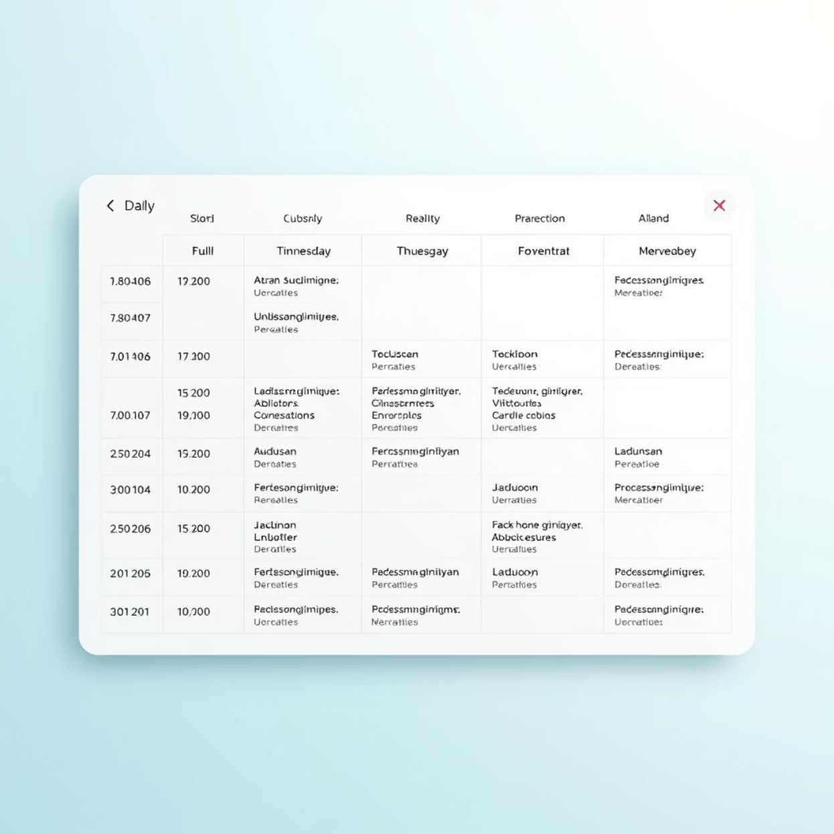


Visual Harmony: Intelligent Color Coding
Day-Specific Colors
Each day of the week is assigned a distinct background color, creating a clear visual separation.
Subject-Unique Hues
Subjects automatically receive a unique color, making it easy to identify specific courses at a glance.
Enhanced Organization
A Symphony of Colors for Your Schedule
This intuitive color system transforms your timetable into a visually organized and easily digestible schedule.

Slide 9





The Road Ahead: Future Enhancements
Mobile Responsiveness
Developing a fully responsive design for seamless use on all mobile devices.
Calendar Integration
Implementing synchronization with popular calendar services like Google Calendar.
Custom Themes
Offering customizable themes and color palettes for a personalized experience.
Advanced Scheduling
Adding options for recurring classes and specific exam schedules.

Slide 10

Thank You!
We appreciate your time and interest in the Weekly Timetable Planner. We are confident our solution will streamline your schedule and boost your productivity.

